Slide 1
DSAA Final Project Review
Digital Hearing Aids
Group 51

Slide 2
Prelude

Slide 3
The Problem
Hearing Loss
What is Hearing Loss?
Ski-slope Hearing Loss
Approximately 10% of the world’s population (760 million people) suffers from some level of hearing loss
Yet only a small percentage of this statistic use a hearing aid
Hearing loss is not just a technical loss of volume rather, hearing deficiency can increase sensitivity and reduce tolerance to certain sounds while diminishing sensitivity to others.
One of the major kind’s of hearing loss is the Ski-slope hearing loss
When a person has problems hearing high frequency sounds the hearing curve looks like a ski slope in an audiogram

Slide 4
Problem Statement

Slide 5
Generally, a Hearing aid has 3 basic parts :
Microphone
Amplifier
Speaker
i/p
o/p
By designing the amplifier digitally, i.e. Digital Hearing Aids which convert
sound waves into numerical codes before amplifying them and which can be programmed to perform certain functions on the input audio signal like noise reduction, signal refining etc is more advantageous than an Analog aid.
“Our goal is to implement a hearing aid system in MATLAB for ski-slope hearing loss patients which can denoise the input signal as well as rectify it according to their preferences”

Slide 6
Implementation

Slide 7
Flow – Chart :
Audio Input
Low-pass filter
Addition of Noise
Denoising
Audio Output
Amplitude Compression
Frequency Shaper

Slide 8
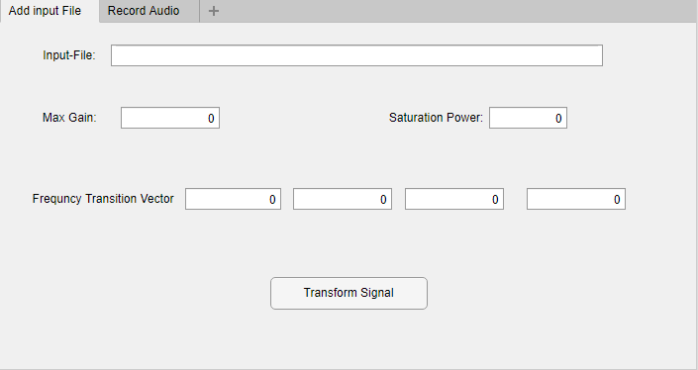
The GUI
Made using MATLAB app designer (guide)

Slide 9
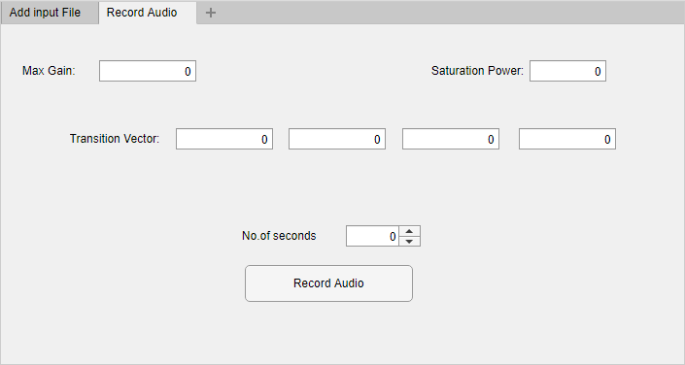
Record Audio

Slide 10
Low pass filter
Input signal is sent through a low pass filter of 20,000hz
Additive White Gaussian Noise is added to the signal
White Noise: A random process signal with a constant power spectral density (PSD) function is a white noise process.
AWGN is a basic noise model used in Information theory to mimic the effect of many random processes that occur in nature.

Slide 11
Denoising
Denoising is done with the help Wavelet Toolbox
A wavelet is a mathematical function useful in digital signal processing and image compression
It has two functions 1) ddencmp( ) 2) wdencmp( )
ddencmp returns default values for denoising or compression for the critically-sampled discrete wavelet or wavelet packet transform.
wdencmp does De-noising of the audio signal

Slide 12
Frequency Shaping
First the signal is converted into Frequency Domain using FFT
Creates the gain filter whose maximum gain will be g_max and the minimum gain will be one. The magnitude of gain function will be the concatenation of piecewise functions.
Transition Frequencies are calculated by the Transition Vector, a set of 4 values determined by an audiologist, that define the user's hearing characteristics.
For each range, the frequency shaper applies a certain gain based on the user's specific hearing loss

Slide 13
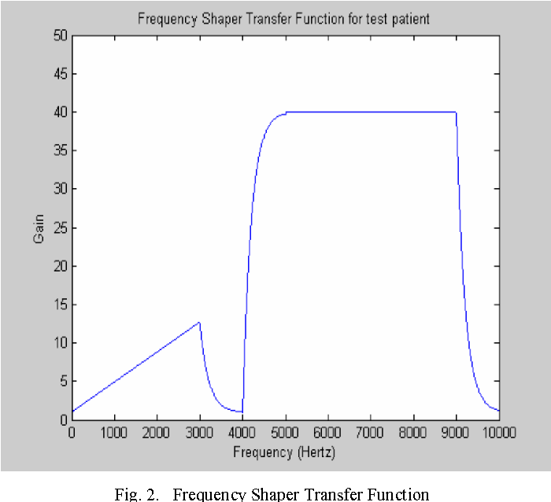
An example Frequency shaper transfer function
Source : Digital filtering in hearing aid system for the hearing impaired - Ritwik Dhawan, P. Mahalakshmi - Published 2016

Slide 14
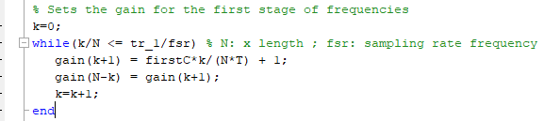
Frequency Shaping – Code Snippet

Slide 15
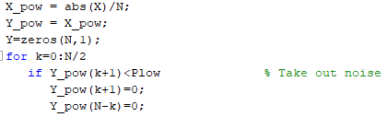
Amplitude Compression
Takes in an input signal and amplifies it and makes sure that the maximum power in any frequency is less than or equal to P_sat
Also had some denoising capabilities, by zeroing out very low power frequencies.
Plow is taken as 0.01

Slide 16
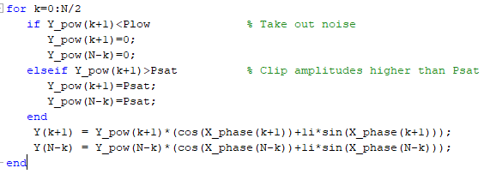
Amplitude Compression (Contd.)

Slide 17
Results & Analysis

Slide 18
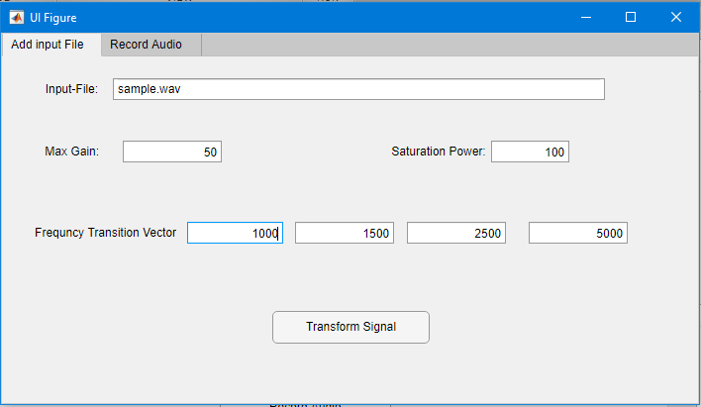
Input File Method :

Slide 19
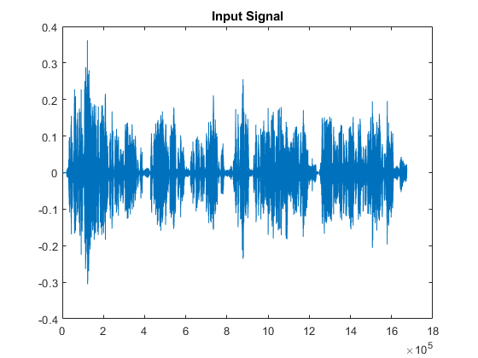
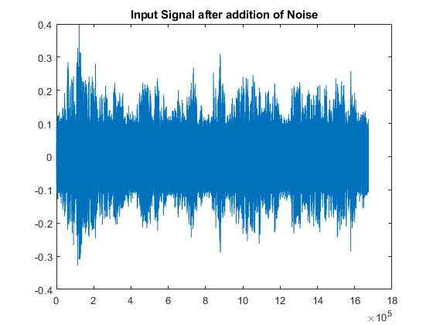
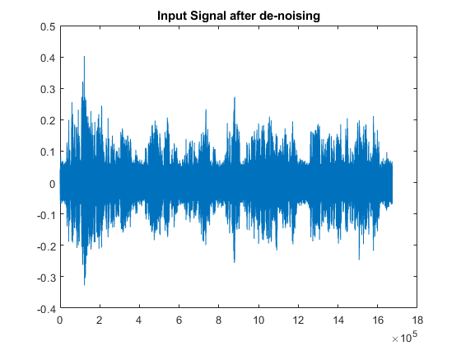
Result

Slide 20
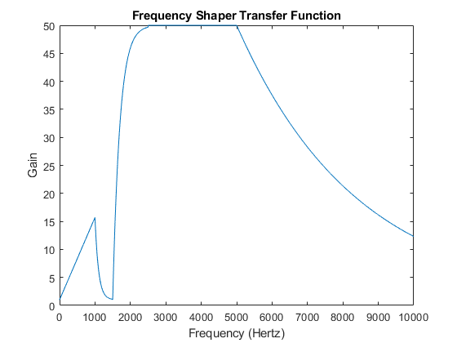
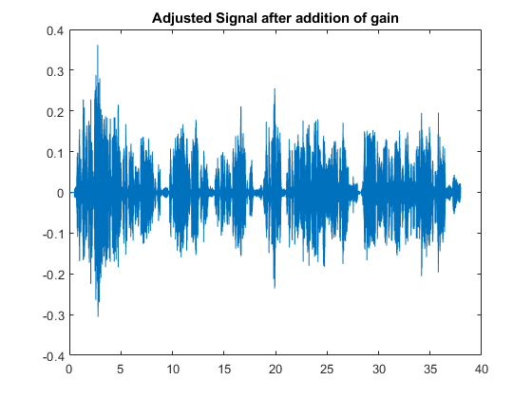
Result (Contd.)

Slide 21
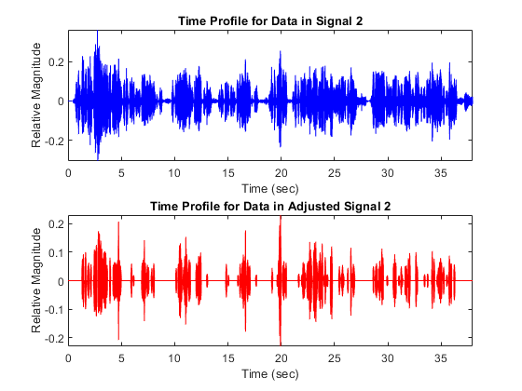
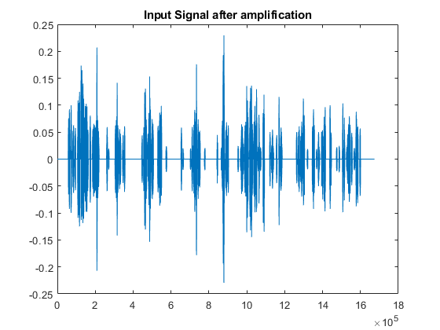
Result (Contd.)

Slide 22
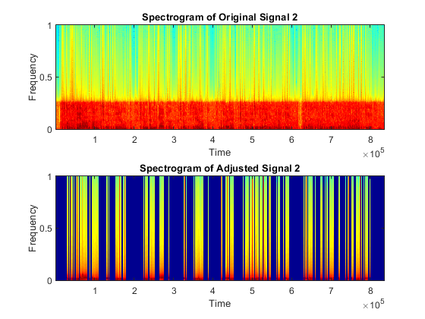
Analysis : Input vs Output

Slide 23
Analysis : Input vs Output
[ Unfortunately we weren’t able to show any automated way of validation for our project ]

Slide 24
References

Slide 25
References
Digital Hearing Aid for Ski-Slope Hearing Loss : https://research.ijcaonline.org/ncesc2017/number4/ncesc2017120.pdf
Semantic Scholar : Digital filtering in hearing aid system for the hearing impaired - Ritwik Dhawan, P. Mahalakshmi - Published 2016

Slide 26
Thank You!
Our Git Hub Repository : https://github.com/nikhilsampangi/Digital_Hearing_Aids

